Slide 2
Data Explanation
1. Participants (1010 rows) :
2. Survey Questions(150 items columns):
Music preferences (19 items)
Movie preferences (12 items)
Hobbies & interests (32 items)
Phobias (10 items)
Health habits (3 items)
Personality traits, views on life, & opinions (57 items)
Spending habits (7 items)
Demographics (10 items)

Slide 3
Quantitative & Categorical Variables
Survey Questions(139):
I always keep my promises.:
Strongly disagree 1-2-3-4-5 Strongly agree (integer)
Categorical Questions(11):
Smoking Habits
Never smoked - Tried smoking - Former smoker - Current smoker (categorical)

Slide 4
Variable Definition
Y: Age(in demographics category)
Xs: all other 149 survey questions
Music preferences, Movie preferences, Hobbies, etc.
Intuition:
Identify correlation between Age and all other survey questions
Build regression models to predict age

Slide 5
Stepwise V.S. Brute Force
Stepwise: (38*39)/2= 741 Seconds or 12.35 Mins
(My Mac → under 3 mins)
Brute Force: 2¹⁵⁰ = 7.1362385e+44
Take forever to finish

Slide 6
Stepwise Selection(Level 1,2)
Level 1: Included all variables, linear regression model
R²= 0.6478 R²_{a}=0.544 PRESS =3152.945 R²_{jack} = 0.3727
(Base Model, improve upon)
Level 2: Stepwise selection(38 variables selected)
R²= 0.585 R²_{a}=0.561 PRESS =3139.057 R²_{jack} = 0.4604

Slide 7
Stepwise Selection(Level 3)
Level 3: Excluded insignificant & unrelated variables(8)
& Combined Terms(2)
R²= 0.598 R²_{a}=0.5765 PRESS =3063.743 R²_{jack} = 0.5507
Terms deleted for Level 3:
Branded clothing high p value →0.086
Cheating in school high p value →0.144
Is only child → irrelevant
block of flat VS bungalow → irrelevant
Term modified for Level 3
internet usage & smoking

Slide 8
Stepwise Selection(Level 4)
Level 4: Add Interaction Terms
R²=0.599 R²_{a}=0.5760 PRESS =3085.696 R²_{jack} = 0.4525
reliable_waiting=reliable * waiting
questionnair_gadget=questionnair*gadgets
opera_gardening=opera*gardening
weight_reliable=weight * reliable

Slide 9
Final Model: Level 3
Level 1: R²= 0.6478 R²_{a}=0.544 PRESS =3152.945 R²_{jack} = 0.3727
Level 2: R²= 0.585 R²_{a}=0.561 PRESS =3139.057 R²_{jack} = 0.4604
Level 3: R²= 0.598 R²_{a}=0.5765 PRESS =3063.743 R²_{jack} = 0.5507
Level 4: R²=0.599 R²_{a}=0.5760 PRESS =3085.696 R²_{jack} = 0.4525

Slide 10
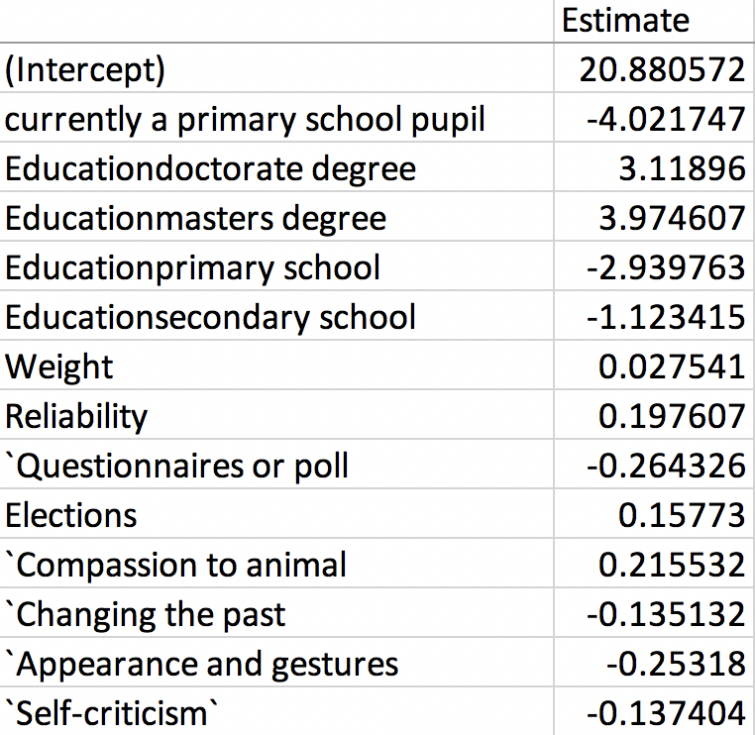
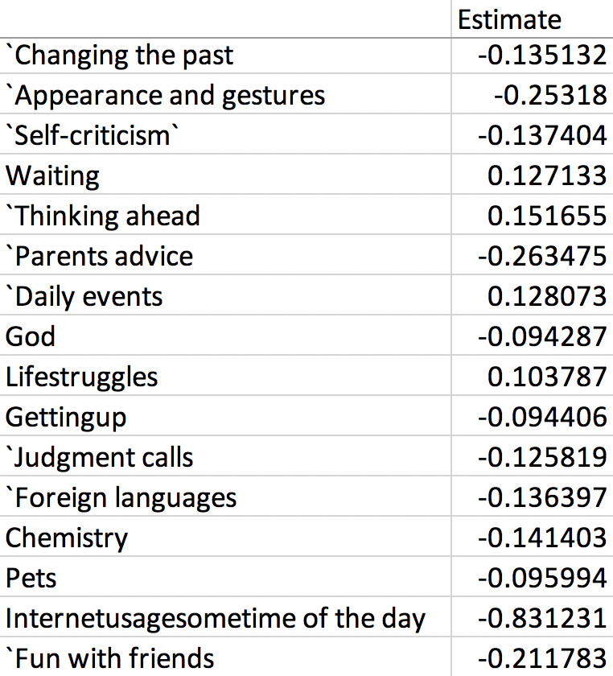
Interpretations

